Slide 1
SIEM: Security Information and Event Management System
Dr. Arshad Farhad

Slide 2
Lecture Content:
SIEM
Working
What is SIEM?
How does it work?
What it does?
Logs
How logs reach SIEM?
Capabilities
Alerts
How alerts are generated?

Slide 3
SIEM
SIEM: A security software solution that combines Security Information Management (SIM) and Security Event Management (SEM)
Collects, analyzes, and correlates data from various IT systems
Provides real-time insights and actionable intelligence for threat detection and incident response
SIM: Security Information Management refers to the collection of log files and storage in a central repository for later analysis.
SIM is therefore also referred to as log management
SEM: Security Event Management is a tool to identify, gather, monitor, evaluate system events and alerts.
Both SIM and SEM are distinct areas of security management.

Slide 4
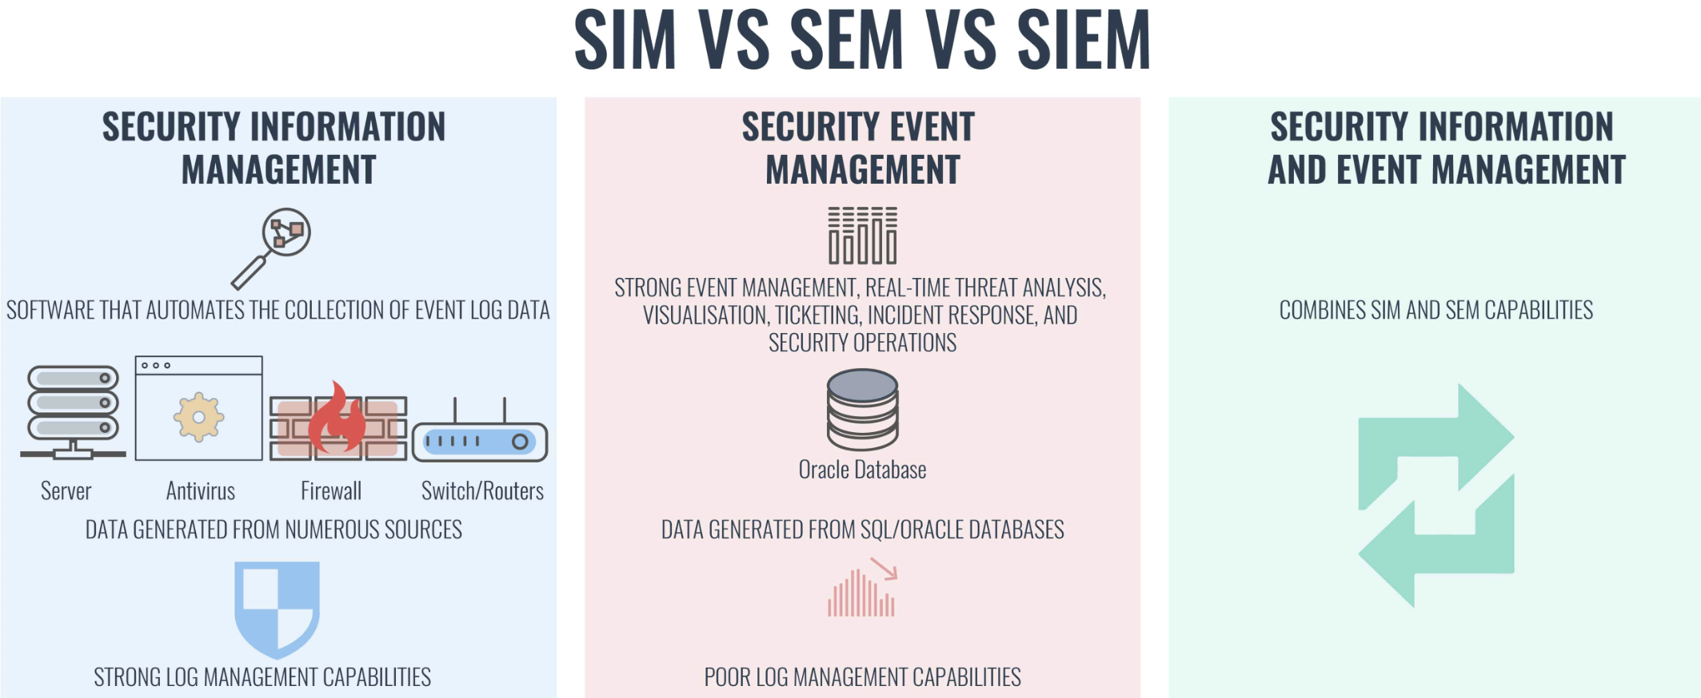
SIEM

Slide 5
Threat Detection - The Watchful Guardian
The proactive process of identifying potential security threats within your IT infrastructure before they escalate into full-blown incidents.
Log Analysis
Anomaly Detection
Threat Intelligence
Scrutinizing system logs for suspicious activities like unauthorized access attempts or malware signatures
Identifying deviations from normal system behavior that could indicate a threat.
Leveraging external threat feeds and insights to stay ahead of emerging cyber threats.

Slide 6
Threat intelligence
Threat intelligence refers to information that is collected, analyzed, and disseminated to understand and mitigate cybersecurity threats.
It involves the gathering of data about potential and current cyber threats, including the tactics, techniques, and procedures (TTPs) employed by threat actors.
The primary goal of threat intelligence is to enable organizations to make informed decisions to protect their systems, networks, and data from cyber threats.

Slide 7
Incident Response - The Rapid Responder
The reactive process of mitigating the impact of a security incident and restoring normal operations as quickly as possible.
Containment
Limiting the spread of the threat and preventing further damage
Recovery
Restoring affected systems and data to their previous state
Eradication
Post-mortem analysis
Eliminating the source of the incident, such as malware or compromised accounts
Learning from the incident to improve future security posture

Slide 8
Key Functions of SIEM
01
02
03
04
Collect Data from Sources
Aggregate Data
Discover & Detect threats
Identify security breaches & investigate alerts
Notes:
The first stage is collecting data from various sources around.
It then combines all such collected data.
In the next process, it starts examining the data to discover threats.
Identifies security breaches and alerts organizations about such threats.

Slide 9
Benefits of Implementing SIEM
Proactive Threat Detection
Enhanced Security Posture
Compliance and Regulation
Reduced Security Costs
Early identification of security threats and vulnerabilities
Improved situational awareness and incident response capabilities
Streamlines adherence to data security regulations (PCI-DSS, HIPAA, etc.)
Proactive threat mitigation minimizes potential damage and costs associated with security breaches

Slide 10
Core Components of a SIEM System
Data Collectors | Gather log and event data from various sources
Log Management | Store and manage collected data efficiently for analysis
Correlation Engine | Analyzes data for suspicious patterns and anomalies
Alerting and Reporting Module | Triggers alerts for potential threats and generates security reports
User Interface | Provides a centralized platform for security analysts to monitor and manage the system

Slide 11
Implementation of the SIEM process
The organization should have three team members for the successful implementation of the SIEM process
Security
Operation
They will circulate all the information and alerts.
They will examine the logs, events, and other security incidents
Compliance
They will handle the data. They will also compile with the rules of industry and government rules.
https://www.comodo.com/what-is/the-siem-process.php

Slide 12
Challenges of Implementing SIEM
Data Overload and Complexity
Integration and Deployment
Alert Fatigue
Managing large volumes of data from diverse sources
Excessive and irrelevant alerts can lead to analyst fatigue and missed threats
Requires integration with existing security infrastructure and skilled personnel for deployment and maintenance

Slide 13
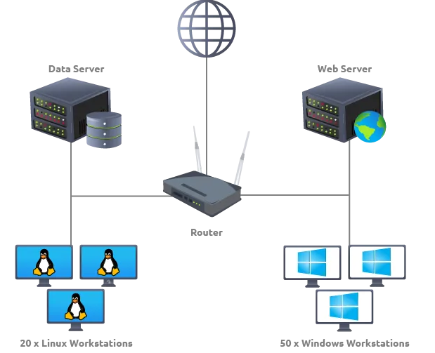
Network Visibility through SIEM
Example of a simple network that comprises multiple Linux/Windows based Endpoints
One data server, and one website.
Each Windows-based component communicates with the other or accesses the internet through a router.
Each network component can have one or more log sources generating different logs.
One example could be setting up Sysmon along with Windows Event logs to have better visibility of Windows Endpoint.
https://medium.com/@exploit_daily/tryhackme-introduction-to-siem-755c6ff3c41f
Sysmon: Windows system service and device driver that, once installed on a system, remains resident across system reboots to monitor and log system activity to the Windows event log. It provides detailed information about process creations, network connections, and changes to file creation time)

Slide 14
Log Sources: Host-Centric Log Sources
These are log sources that capture events that occurred within or related to the host.
Some log sources that generate host-centric logs are Windows Event logs, Sysmon, etc.
Some examples of host-centric logs are:
A user accessing a file
A user attempting to authenticate.
A process Execution Activity
A process adding/editing/deleting a registry key or value.
regedit
Powershell execution.
PowerShell's execution policy is a safety feature that controls the conditions under which PowerShell loads configuration files and runs scripts. This feature helps prevent the execution of malicious scripts

Slide 15
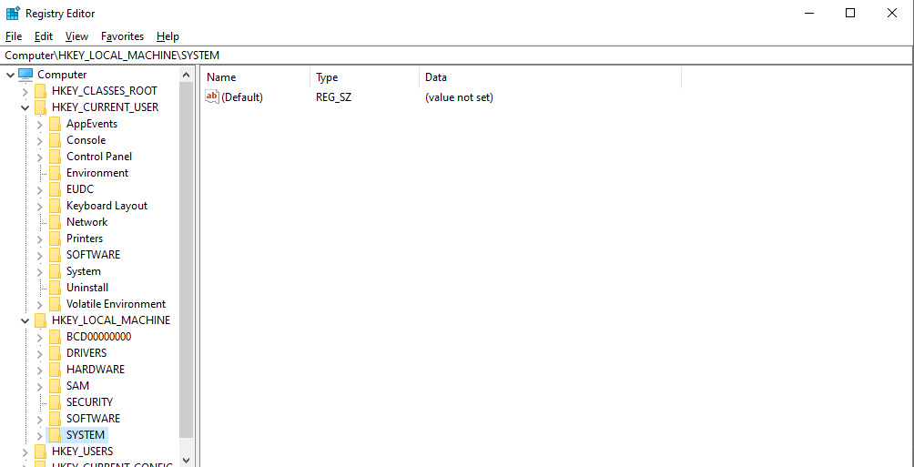
Log Sources: Host-Centric Log Sources

Slide 16
Log Sources: Network-Centric Log Sources
Network-related logs are generated when the hosts communicate with each other or access the internet to visit a website. Some network-based protocols are SSH, VPN, HTTP/s, FTP, etc. Examples of such events are.
Some examples of Network-centric logs are:
SSH connection
SSH is a network communication protocol that enables two computers to communicate (http or hypertext transfer protocol, which is the protocol used to transfer hypertext such as web pages) and share data
A file being accessed via FTP
Web traffic
A user accessing company’s resources through VPN.
Network file sharing Activity

Slide 17
Log Sources and Log Ingestion
A log source is a data source that creates an event log. For example, a firewall or intrusion protection system (IPS) logs security-based events, and switches or routers logs network-based events.
Ingestion refers to the process of formatting and uploading log data from external sources like hosts, applications, and cloud-based logging services.

Slide 18
Log Sources and Log Ingestion: Windows
Windows records every event that can be viewed through the Event Viewer utility.
It assigns a unique ID to each type of log activity, making it easy for the analyst to examine and keep track of.
To view events in a Windows environment, type Event Viewer in the search bar, and it takes you to the tool where different logs are stored and can be viewed, as shown below.
These logs from all windows endpoints are forwarded to the SIEM solution for monitoring and better visibility.

Slide 19
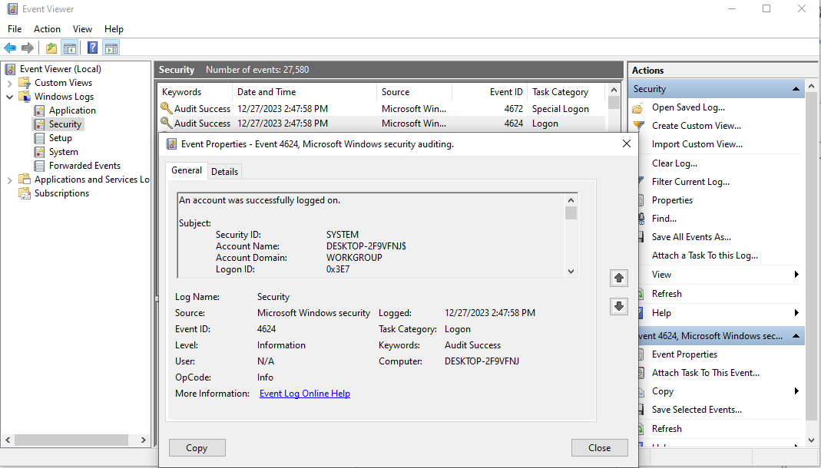
Log Sources and Log Ingestion: Windows

Slide 20
Log Sources and Log Ingestion: Linux
Linux OS stores all the related logs, such as events, errors, warnings, etc. Which are then ingested into SIEM for continuous monitoring. Some of the common locations where Linux store logs are.
/var/log/httpd : Contains HTTP Request / Response and error logs.
/var/log/cron : Events related to cron jobs are stored in this location.
A cron job is a Linux command used for scheduling tasks to be executed sometime in the future. This is normally used to schedule a job that is executed periodically – for example, to send out a notice every morning.
/var/log/auth.log and /var/log/secure : Stores authentication related logs.
/var/log/kern: This file stores kernel related events.

Slide 21
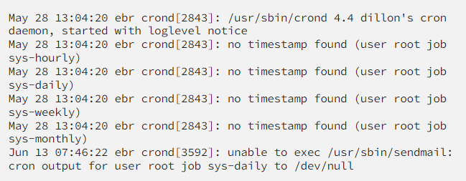
Log Sources and Log Ingestion: Linux
Here is a sample of a cron log:

Slide 22
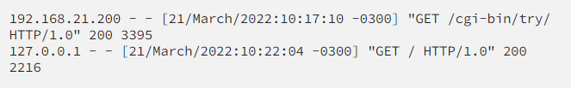
Log Sources and Log Ingestion: Web Server
It is important to keep an eye on all the requests/responses coming in and out of the webserver for any potential web attack attempt. In Linux, common locations to write all apache related logs are /var/log/apache or /var/log/httpd.
Here is an example of Apache Logs:

Slide 23
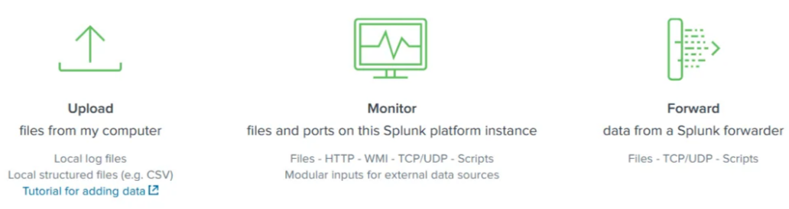
Log Ingestion:
Agent / Forwarder: These SIEM solutions provide a lightweight tool called an agent (forwarder by Splunk) that gets installed in the Endpoint. It is configured to capture all the important logs and send them to the SIEM server
Syslog: Syslog is a widely used protocol to collect data from various systems like web servers, databases, etc., are sent real-time data to the centralized destination.
Manual Upload: Some SIEM solutions, like Splunk, ELK, etc., allow users to ingest offline data for quick analysis. Once the data is ingested, it is normalized and made available for analysis.
Port-Forwarding: SIEM solutions can also be configured to listen on a certain port, and then the endpoints forward the data to the SIEM instance on the listening port.

Slide 24
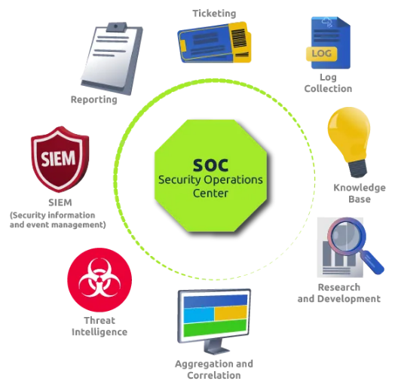
SOC Analyst Responsibilities
SOC Analysts utilize SIEM solutions in order to have better visibility of what is happening within the network. Some of their responsibilities include:
Monitoring and Investigating.
Identifying False positives.
Tuning Rules which are causing the noise or False positives.
Reporting and Compliance.
Identifying blind spots in the network visibility and covering them.

Slide 25
Analyzing logs and alerts
Analyzing logs and alerts: SIEM tool gets all the security-related logs ingested through agents, port forwarding, etc.
Once the logs are ingested, SIEM looks for unwanted behavior or suspicious pattern within the logs with the help of the conditions set in the rules by the analysts. If the condition is met, a rule gets triggered, and the incident is investigated
Dashboard: Dashboards are the most important components of any SIEM. SIEM presents the data for analysis after being normalized and ingested.
The summary of these analyses is presented in the form of actionable insights with the help of multiple dashboards. Each SIEM solution comes with some default dashboards and provides an option for custom Dashboard creation.

Slide 26
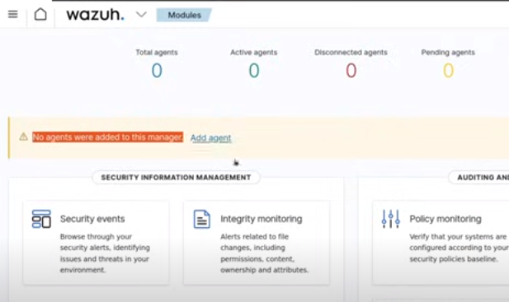
Wazuh: An open source SIEM solution
https://wazuh.com/

Slide 27
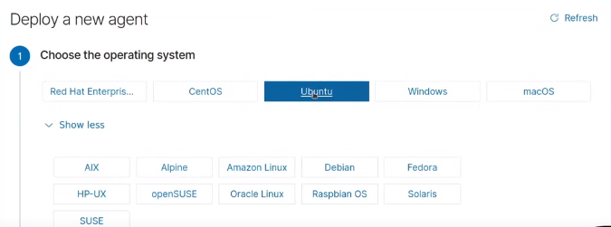
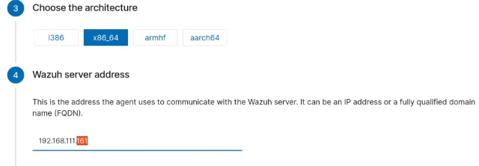
Wazuh: Adding Agent

Slide 28
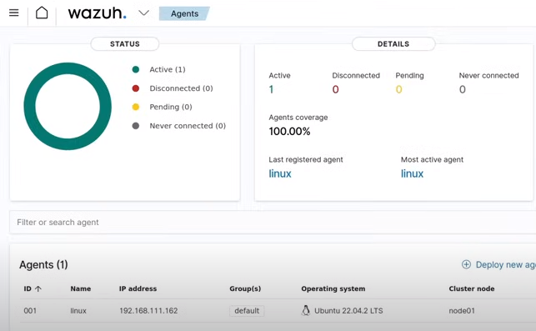
Wazuh: An open source SIEM solution

Slide 29
Thanks!

